Slide 1
Chapter 4 Computer Networks – Part 1
Networks, network characteristics, data transmission

Slide 2
Learning Objectives
Explain what networks are
Identify network characteristics
Understand how data is transmitted over a network

Slide 3
Common uses for computer networks
Sharing an Internet connection among several users
Sharing application software, printers, and other resources
Facilitating Voice over IP (VoIP), email, videoconferencing, IM, and other communications applications
Working collaboratively
Exchanging files among network users and over the Internet
Connecting the computers and entertainment devices located within a home

Slide 4
Networking Applications:
Internet
Telephone
Television and Radio Broadcasting
GPS
Monitoring Systems
Multimedia Networking
Collaborative Computing
Telecommuting
Videoconferencing
Telemedicine

Slide 5
Network Characteristics
Topics Covered:
Wired vs. Wireless Networks
Network Topologies
Network Architectures
Network Size and Coverage Area

Slide 6
Wired vs. Wireless Networks
Wired network -computers and other devices on the network are physically connected via cabling to the network.
Wireless network - wireless signals are used to send data through the air between devices, instead of using physical cables.
Hotspots - wireless networks found in public locations.
Many networks are accessible by both wired and wireless technologies.

Slide 7
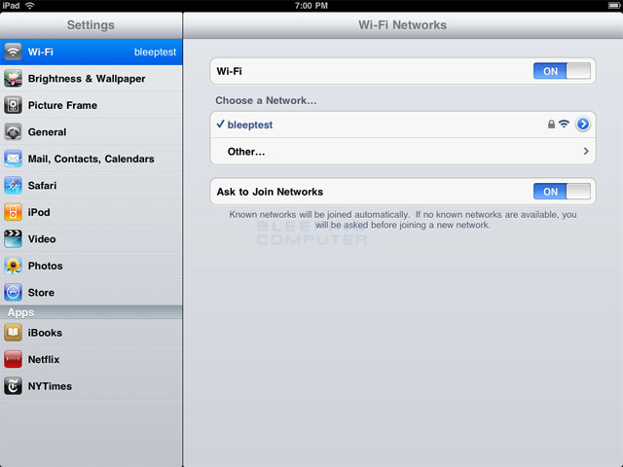
Connecting to Wi-Fi

Slide 8
Network Topologies
The physical topology of a computer network indicates how the devices in the network are arranged.
The three most common physical topologies are:

Slide 9
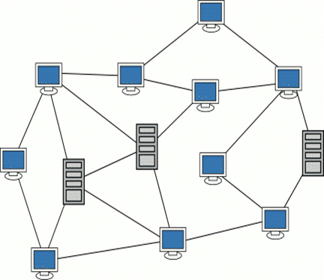
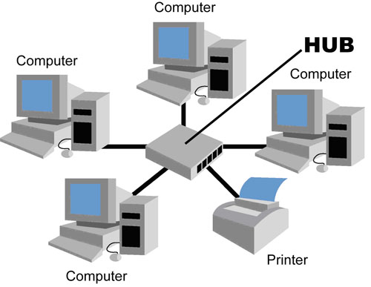
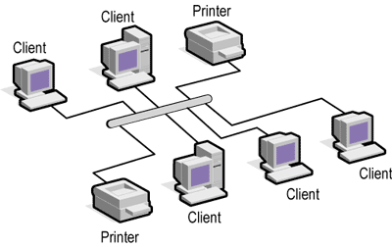
Network Topologies
Star network - A network in which all the net-worked devices connect to a central device through which all network transmissions are sent.
Bus network - A network that uses a central cable to which all network devices connect.
Mesh network - A network that uses a number of different connections between network devices so that data can take any of several possible paths from source to destination.

Slide 10
Network Architectures
Network Architectures: the way computers are designed to communicate
The two main types are:

Slide 11
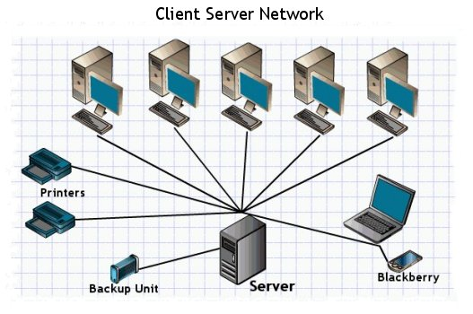
Network Architectures
Client- server networks include
clients, which are computers and other devices on the network that request and use network resources
servers, which are computers that are dedicated to processing cli-ent requests.

Slide 12
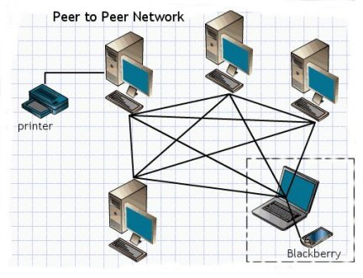
Network Architectures
A peer- to- peer ( P2P) network
has no central server.
all the computers on the network work at the same functional level
users have direct access to the computers and other devices attached to the network.

Slide 13
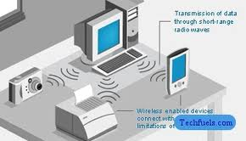
Network Size and Coverage Area
A personal area network (PAN) is a network of personal devices that is designed to enable those devices to communicate and share data.

Slide 14
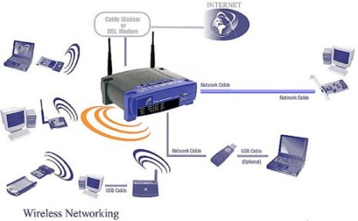
Network Size and Coverage Area
A local area network (LAN) is a network that covers a relatively small geographical area, such as a home, an office building, or a school.

Slide 15
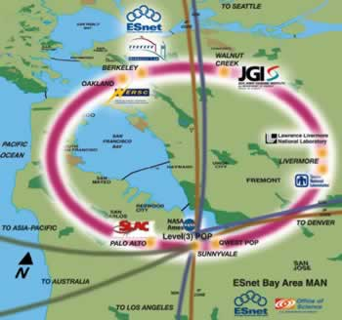
Network Size and Coverage Area
A metropolitan area network (MAN) is a network designed to service a metropolitan area, typically a city or county.

Slide 16
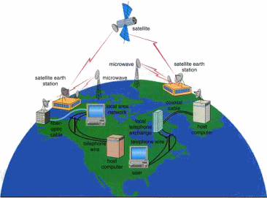
Network Size and Coverage Area
A wide area network (WAN) is a network that covers a large geographical area.
Best example the Internet

Slide 17
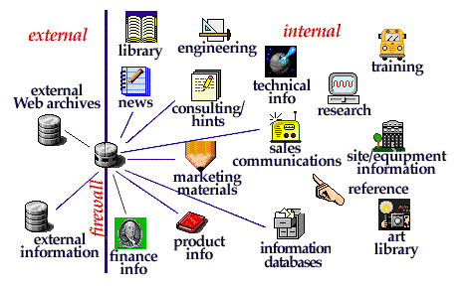
Network Size and Coverage Area
An intranet is
a private network, such as a company LAN, that is designed to be used by an organization’s employees
is set up like the Internet with data posted on Web pages that are accessed with a Web browser
A company network that is accessible to authorized outsiders is called an extranet.

Slide 18
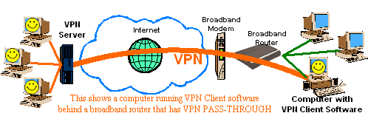
Network Size and Coverage Area
A virtual private network (VPN) is
a private, secure path across a public network (usually the Internet)
It is set up to allow authorized users private, secure access to the company network.

Slide 19
Data Transmission
Topics Covered:
Bandwidth
Analog vs. Digital Signals
Transmission Type and Timing
Delivery Method

Slide 20
Bandwidth
Bandwidth (also called throughput) is `the amount of data that can be transferred in a given time period.
Usualy measured in
bits per second (bps)
Kbps – thousands of bits per second
Mbps - millions of bits per second
Gbps – billions of bits per second.

Slide 21
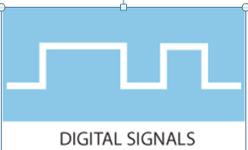

Analog vs. Digital Signals
Most networking media send data using digital signals, in which data is represented by only two discrete states: 0s and 1s.
Analog signals represent data with continuous waves.

Slide 22

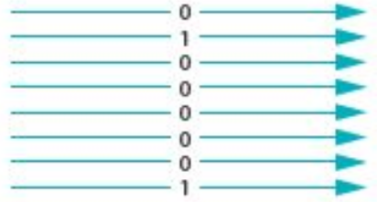
Transmission Type and Timing
With serial transmission, data is sent one bit at a time, one after the other along a single path.
When parallel transmission is used, the message is sent at least one byte at a time, with each bit in the byte taking a separate path.

Slide 23
Transmission Type and Timing
When data is sent using serial transmission, one of the following three techniques is used to organize the bits being transferred so the data can be reconstructed after it is received:

Slide 24
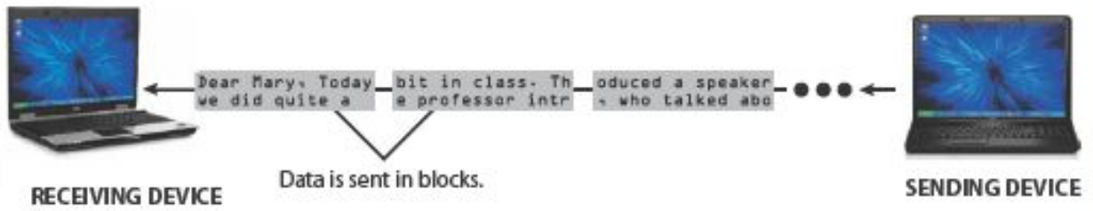
Transmission Type and Timing
Synchronous transmission - serial data transmission in which data is organized into groups or blocks of data that are transferred at regular, specifi ed intervals.:

Slide 25

Transmission Type and Timing
Asynchronous transmission - serial data transmission in which data is sent when it is ready to be sent without being synchronized.

Slide 26
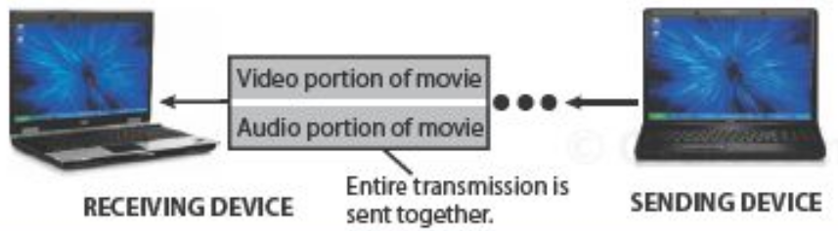
Transmission Type and Timing
Isochronous transmission - serial data transmission in which data is sent at the same time as other related data.

Slide 27
Transmission Type and Timing
Another distinction between the different types of transmissions is the direction in which transmitted data can move.
Simplex transmission A type of data transmission in which data travels in a single direction only.
Half- duplex transmission A type of data transmission in which data can travel in either direction, but only in one direction at a time.
Full- duplex transmission A type of data transmission in which data can move in both directions at the same time.

Slide 28
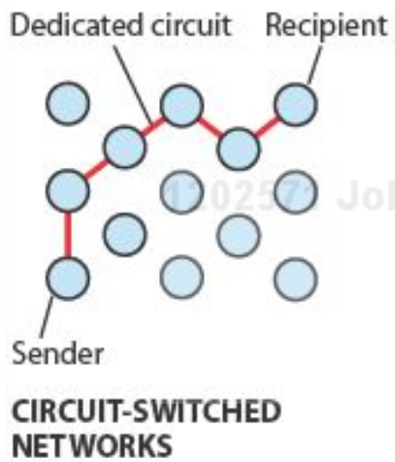
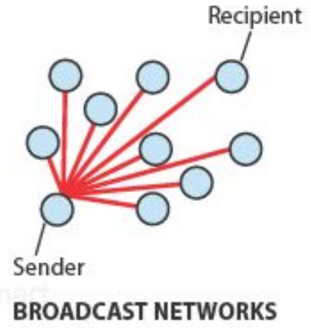
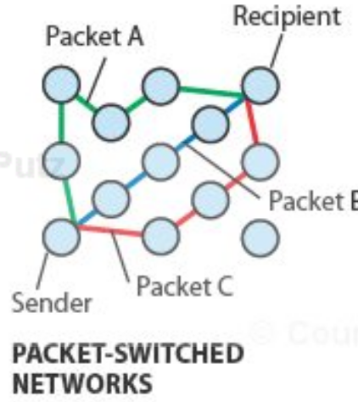
Delivery Method
Circuit switching –uses a dedicated path form the sender to the receiver.
Packet switching - messages are separated into small units called packets.
Broadcasting - when data is sent out, typically in packets, to all nodes on a network and is retrieved only by the intended recipient.

